Slide 1


Python: Introduction
Eng. Mohamed Gamal,
Research Assistant, Center for Photonics and Smart Materials, Zewail City

Slide 2
Outline
Welcome and Introduction to Python
Brief Overview of Python's History
Installing Python
Variables and Data Types
Conditional Statements
Loops
Input and Output
Built-in Functions

Slide 3
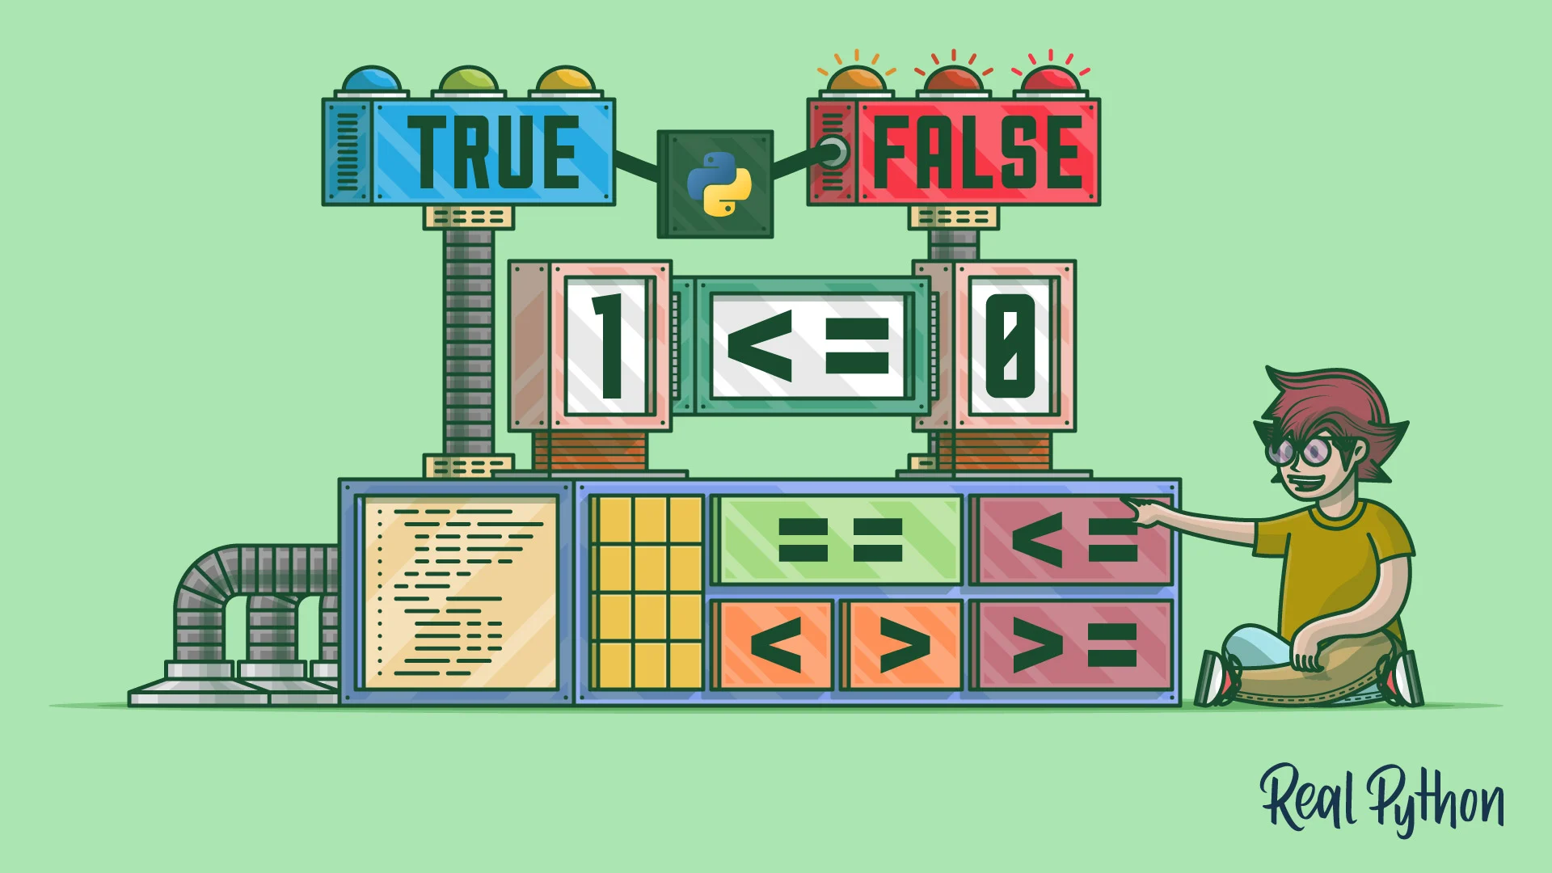
Welcome
Welcome, everyone!
We're excited to have you here for this workshop module on Python. Whether you're new to programming or a seasoned developer, we're confident that you'll find something valuable in this workshop.

Slide 4
Introduction to Python
Python is a high-level, scripting programming language that is widely used for web development, data analysis, scientific computing, machine learning, and more.
Python's syntax is designed to be easy to read and write, making it an excellent language for beginners.
It emphasizes code readability and simplicity, with a minimalist approach that reduces the need for excessive punctuation or complex syntax.

Slide 5
Introduction to Python
Python supports multiple programming paradigms, including procedural, object-oriented, and functional programming.
Python's versatility is due in part to its large and active community, which has created a vast ecosystem of libraries and frameworks.
These libraries and frameworks provide developers with powerful tools for working with data, building web applications, and training machine learning models.

Slide 6
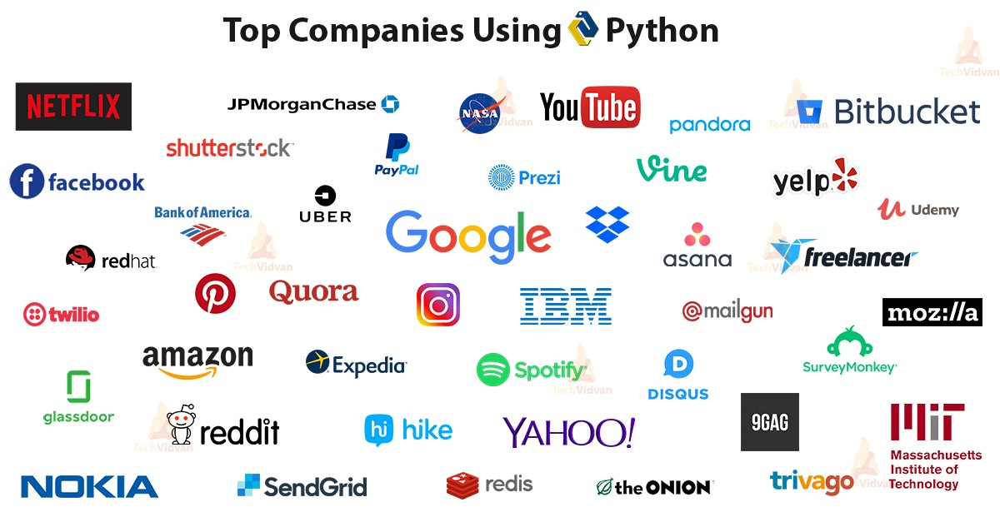
Introduction to Python

Slide 7

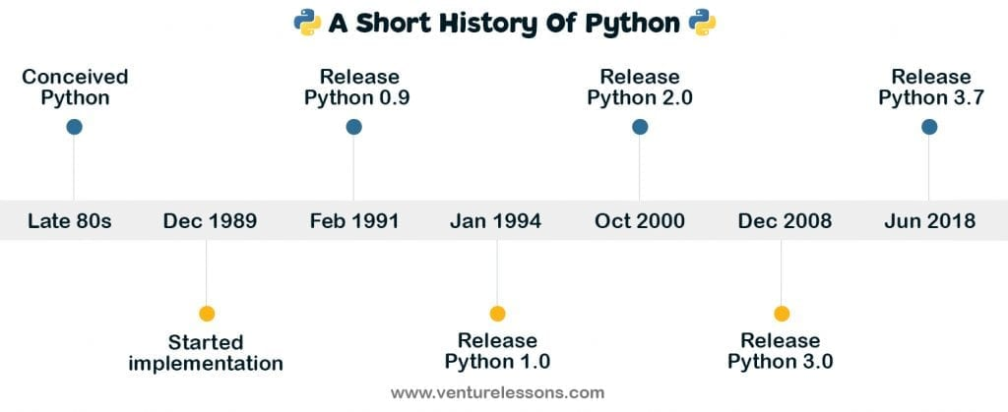
Brief Overview of Python’s History
Invented in the Netherlands, by Guido van Rossum
“Python is an experiment in how much freedom programmers need. Too much freedom and nobody can read another's code; too little and expressiveness is endangered.”
- Guido van Rossum

Slide 8
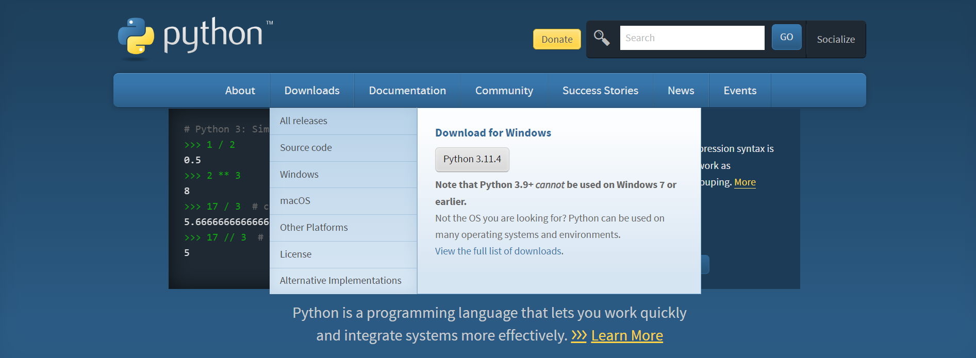
Installing Python
www.python.org

Slide 9
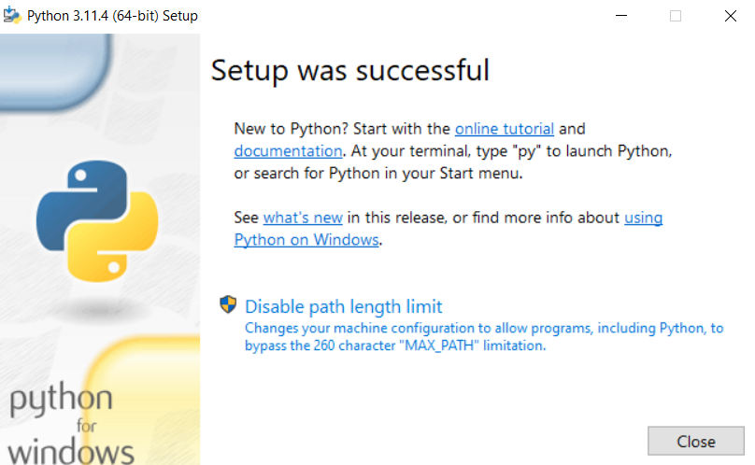
Installing Python

Slide 10
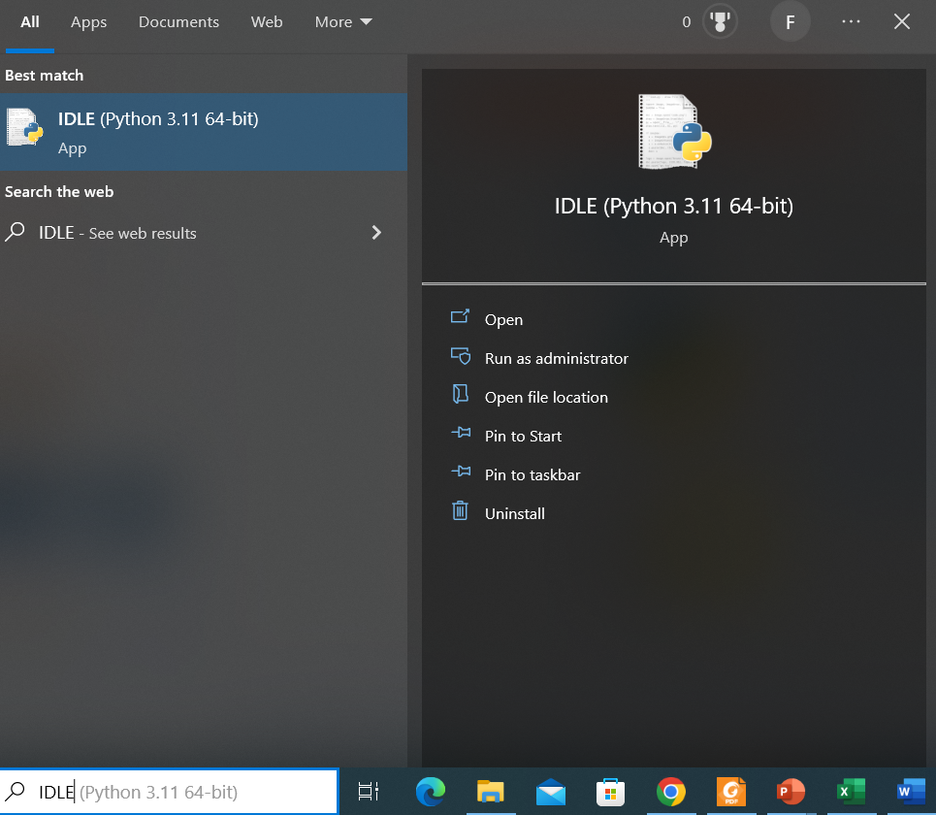
Installing Python

Slide 11
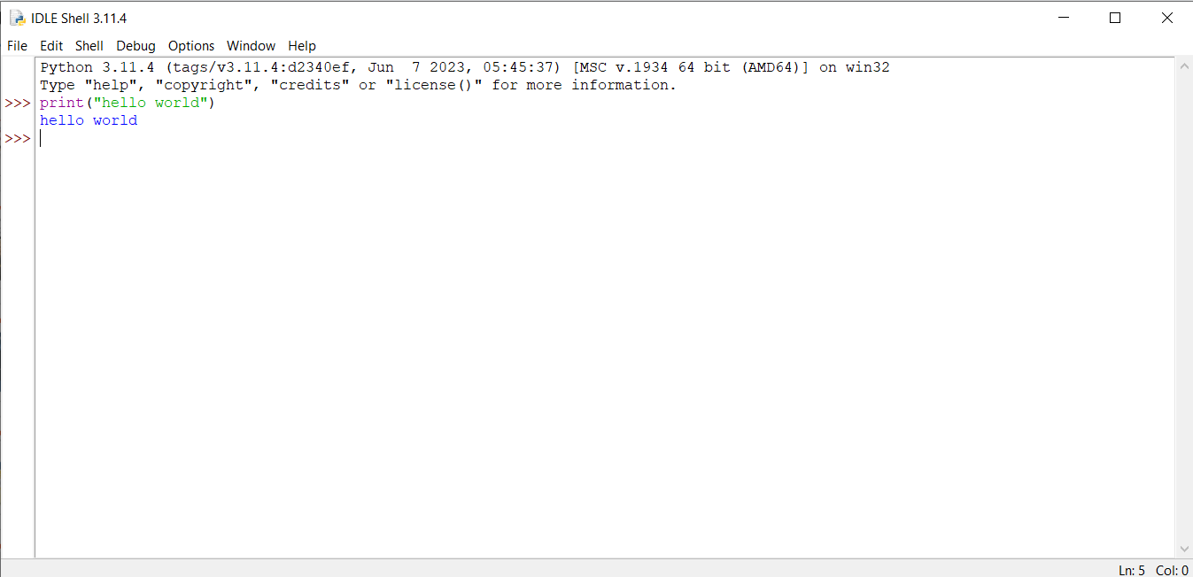
Installing Python

Slide 12
Variables
In Python, a variable is a name that refers to a value stored in the computer's memory. Variables are used to store and manipulate data in a program.
In Python, you can create a variable by assigning a value to it using the equal sign (=).
You can use this variable in your code to perform operations on the value it stores.
The variable can also store a string instead of a number.

Slide 13
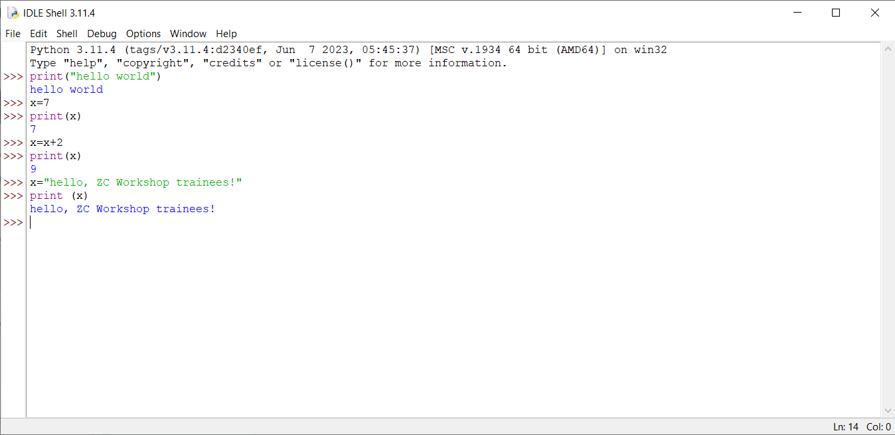
Variables

Slide 14
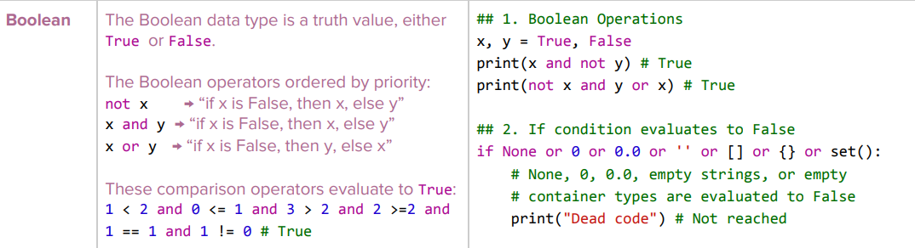
Data Types

Slide 15
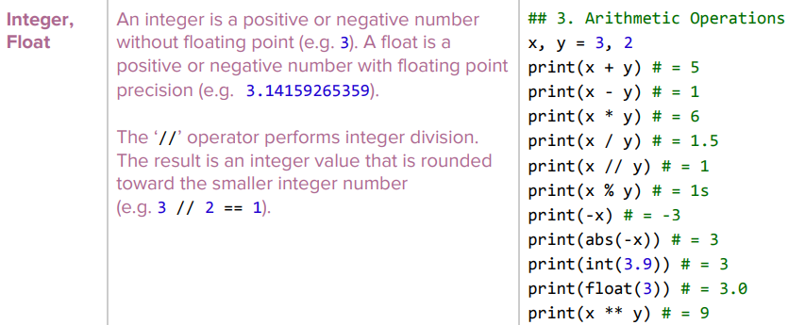
Data Types

Slide 16
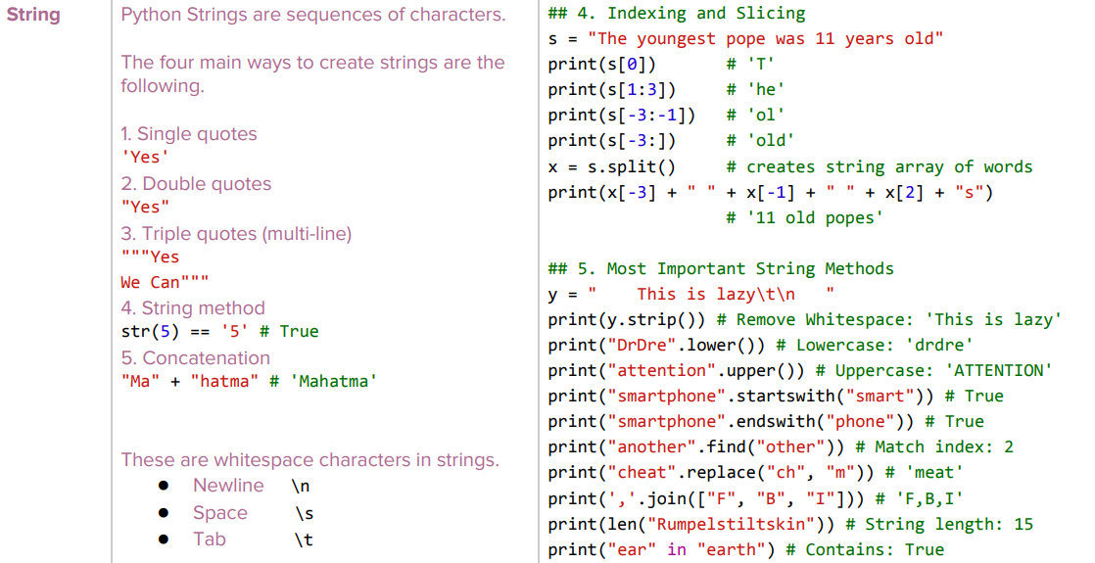
Data Types

Slide 17
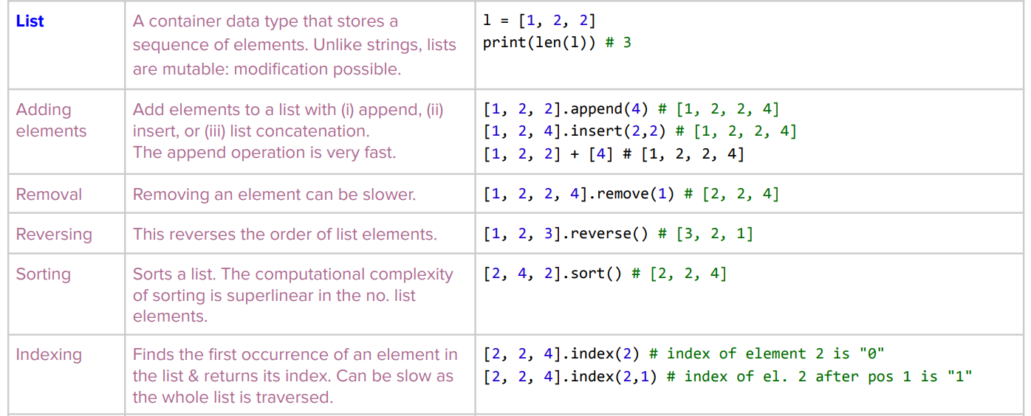
Data Types

Slide 18
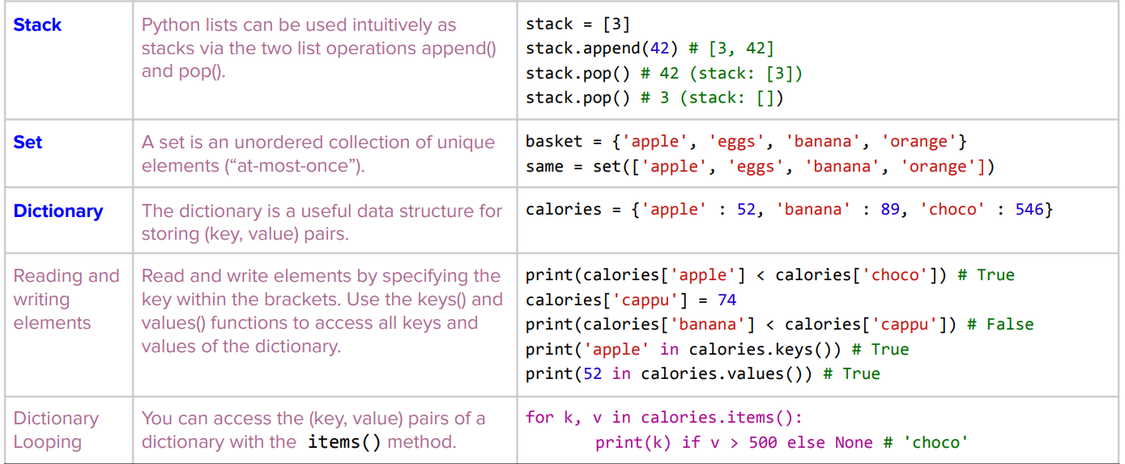
Data Types

Slide 19
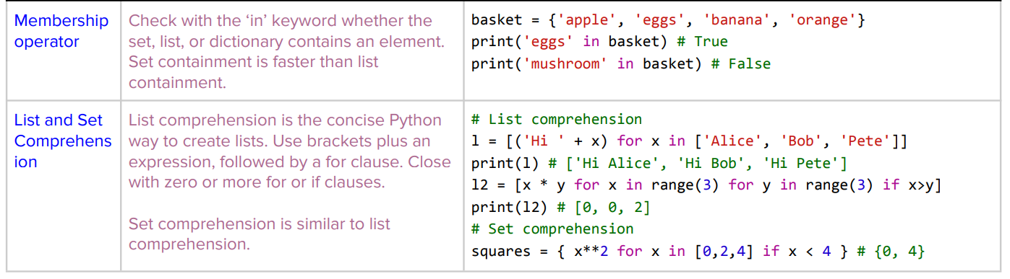
Data Types

Slide 20
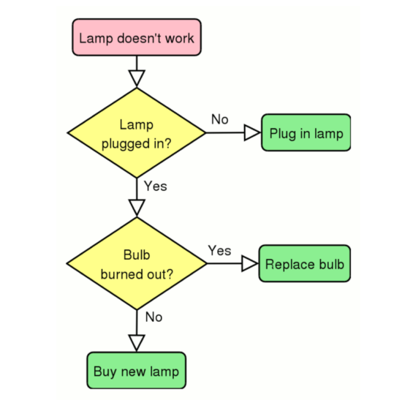
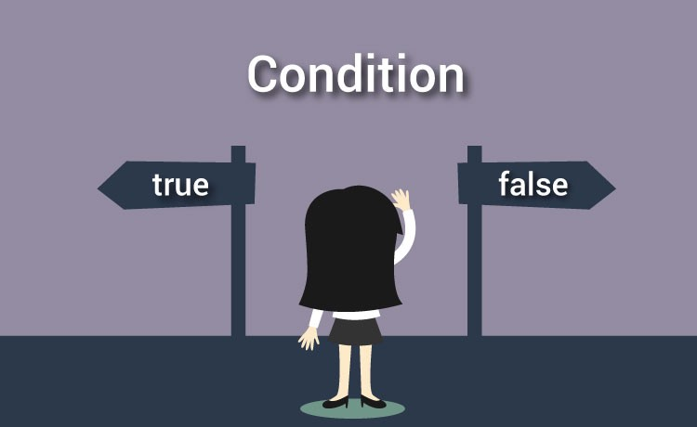
Conditional Statements

Slide 21
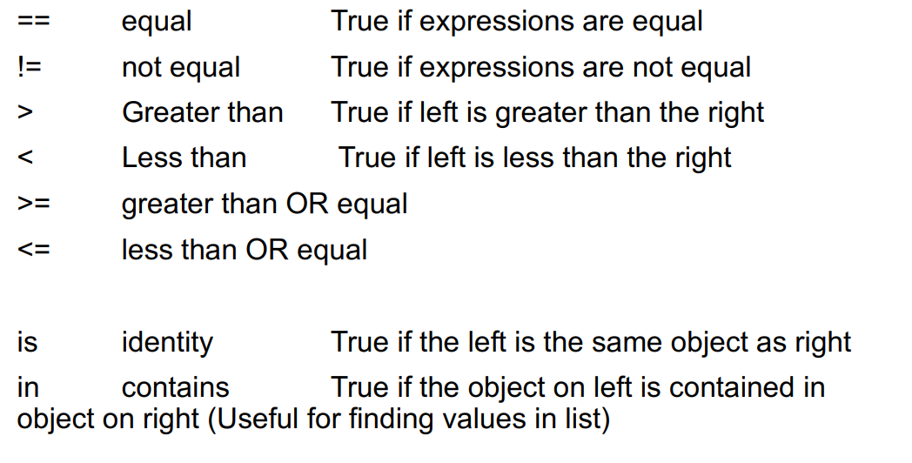
Conditional Statements: Relational Operators

Slide 22
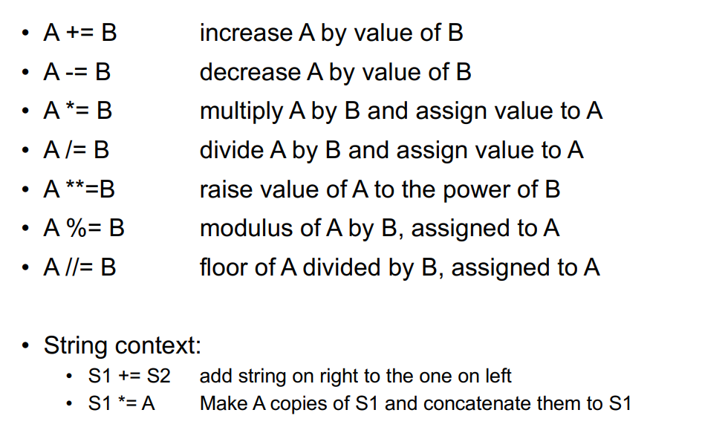
Conditional Statements: Assignment Operators

Slide 23
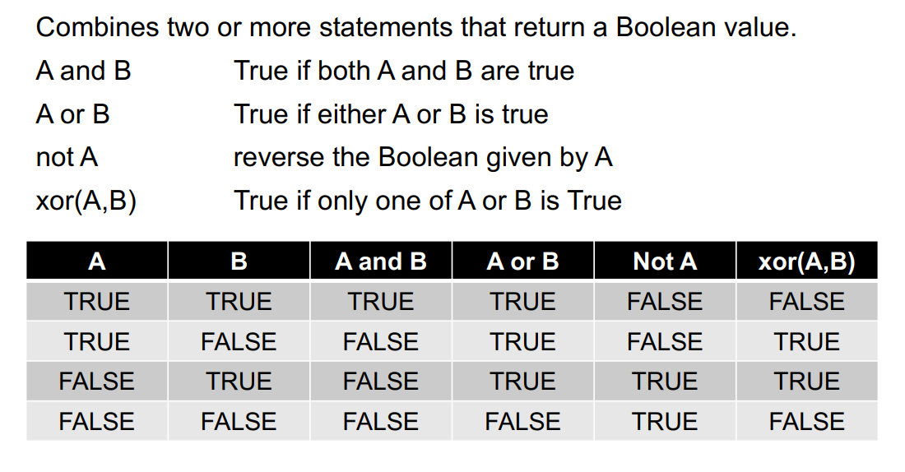
Conditional Statements: Boolean Operators

Slide 24
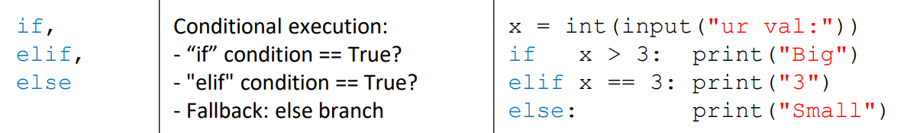
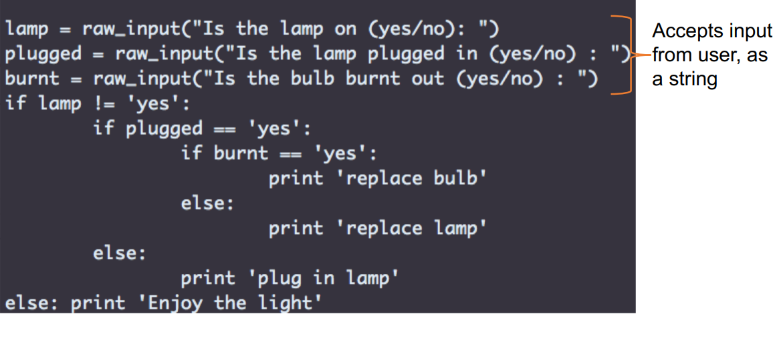
Conditional Statements: If/elif/else

Slide 25
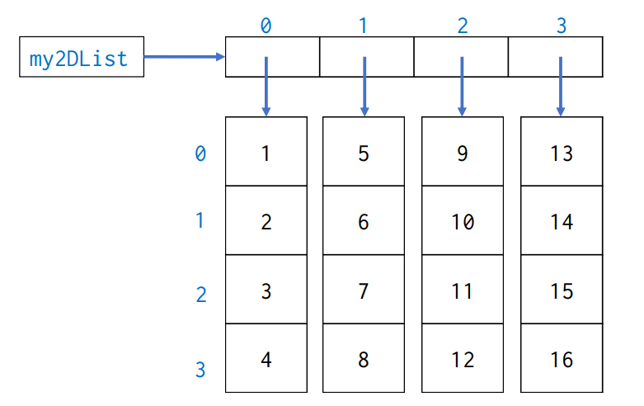
Loops: Multi-dimensional Lists

Slide 26
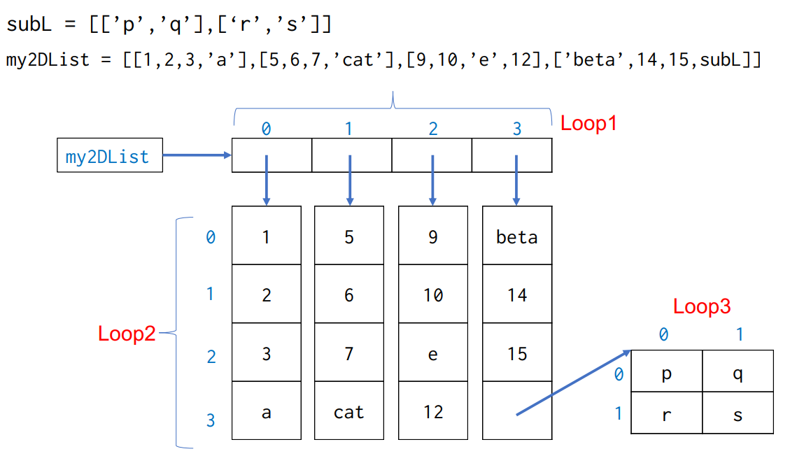
Loops: Arbitrary Lists

Slide 27

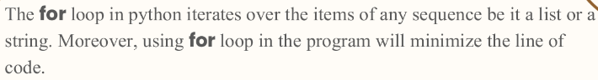
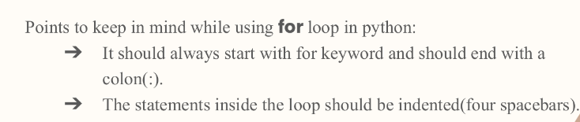
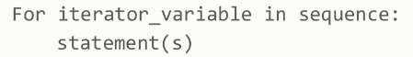
Loops: For Loop

Slide 28
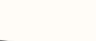
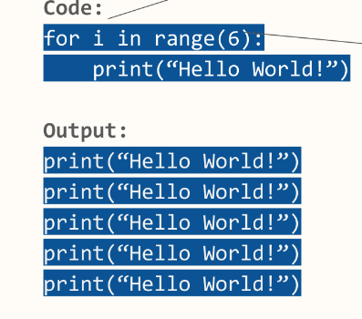

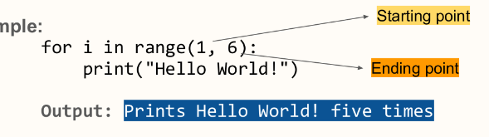
Loops: For Loop

Slide 29
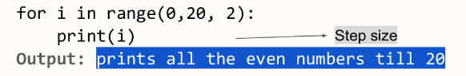
Loops: For Loop
The range() function also takes in another optional parameter i.e. step size. Passing step size in a range() function is important when you want to print the value uniformly with a certain interval.
Step size is always passed as a third parameter where the first parameter is the starting point and the second parameter is the ending point. And if the step_size is not provided it will take 1 as a default step_size.

Slide 30
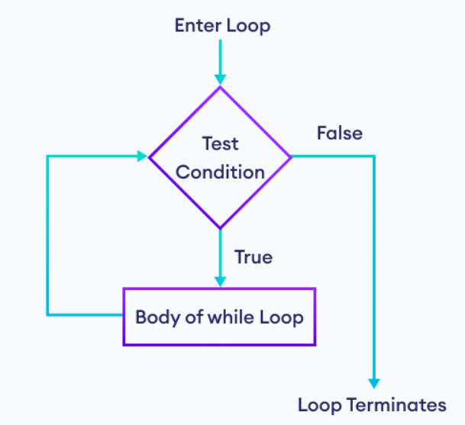
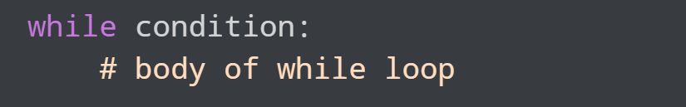
Loops: While Loop
Python while loop is used to run a block code until a certain condition is met.
The syntax of while loop is:

Slide 31
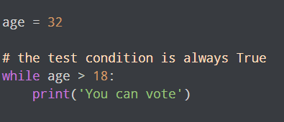
Loops: Infinite While Loop
If the condition of a loop is always True, the loop runs for infinite times (until the memory is full). For example:

Slide 32
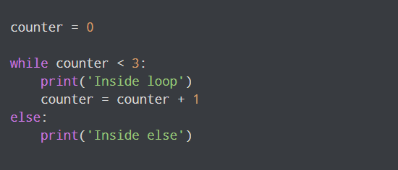
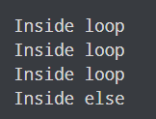
Loops: While-Else Loop
In Python, a while loop may have an optional else block.
Here, the else part is executed after the condition of the loop evaluates to False.

Slide 33
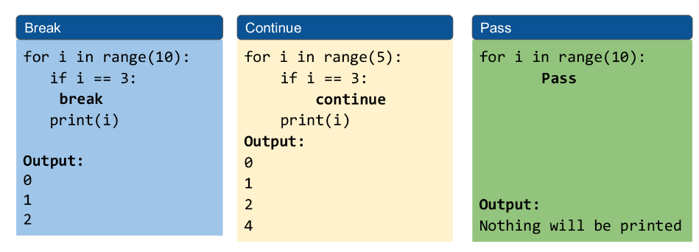
Loops: Control Statements

Slide 34
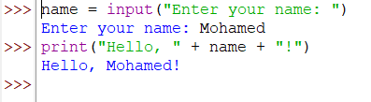
Inputs
The input() function is used to get input from the user. It displays a message to the user and waits for the user to enter some text. The text entered by the user is returned as a string.

Slide 35
Outputs
The print() function is used to print output to the console. It can be used to print strings, numbers, variables, and more. Multiple values can be printed using the comma separator.

Slide 36
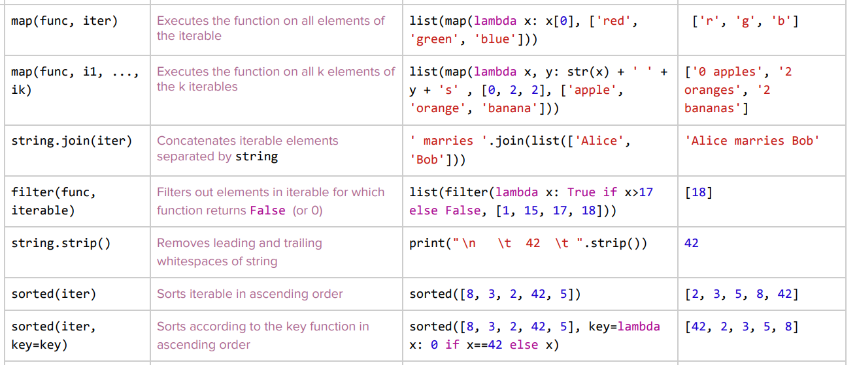
Built-in Functions

Slide 37
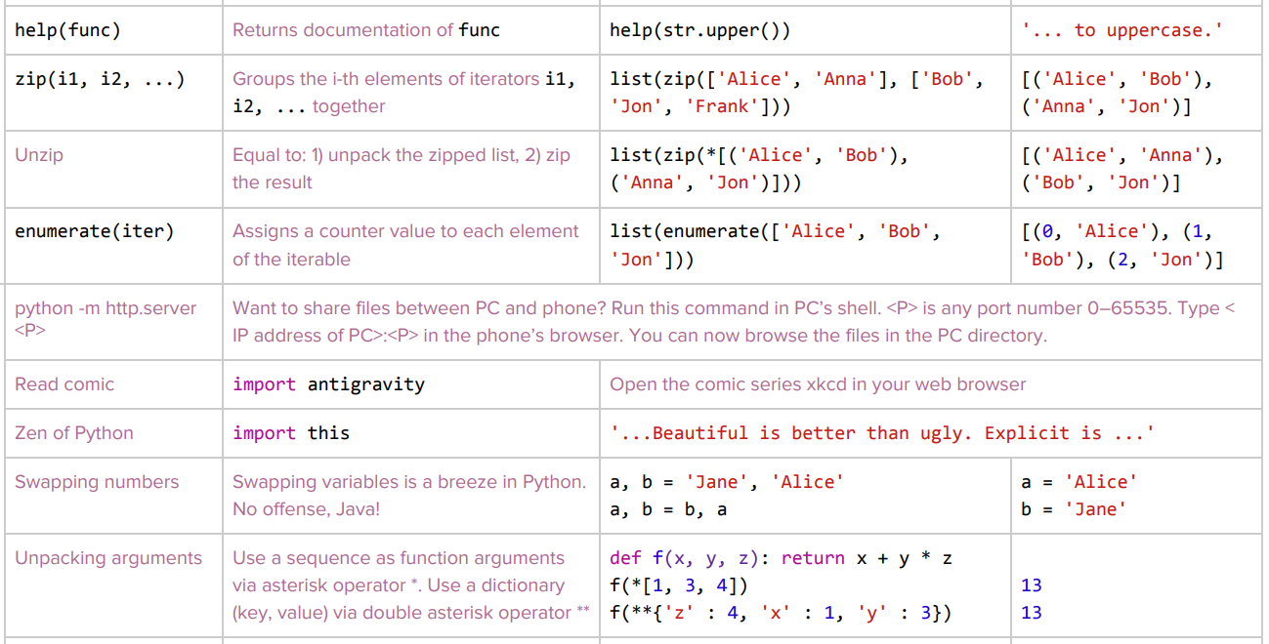
Built-in Functions

Slide 38
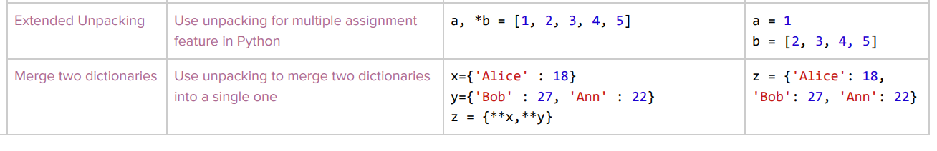
Built-in Functions

Slide 39
Activity I (2 hrs)
In this link: https://www.programiz.com/python-programming/examples , run the code in the following sections using the IDLE software:
Introduction (10 codes)
Native Data Types (16 codes)
Decision Making and Loops (36 codes)

Slide 40
Activity II (30 mins)
Based on your understanding of this portion, you are required to write down a python script that creates a working calculator, it is supposed to take two numbers and an operand (+,-,*,/,**) and then perform the calculations and stores the output in another variable and prints it.

Slide 41
Thank You!

